Slide 1


Healthcare Management System
Group 1 Final Project:
Suveena Save : 002334793
Krisha Lakhani : 002334794
Nikhila B R : 002088992

Slide 2

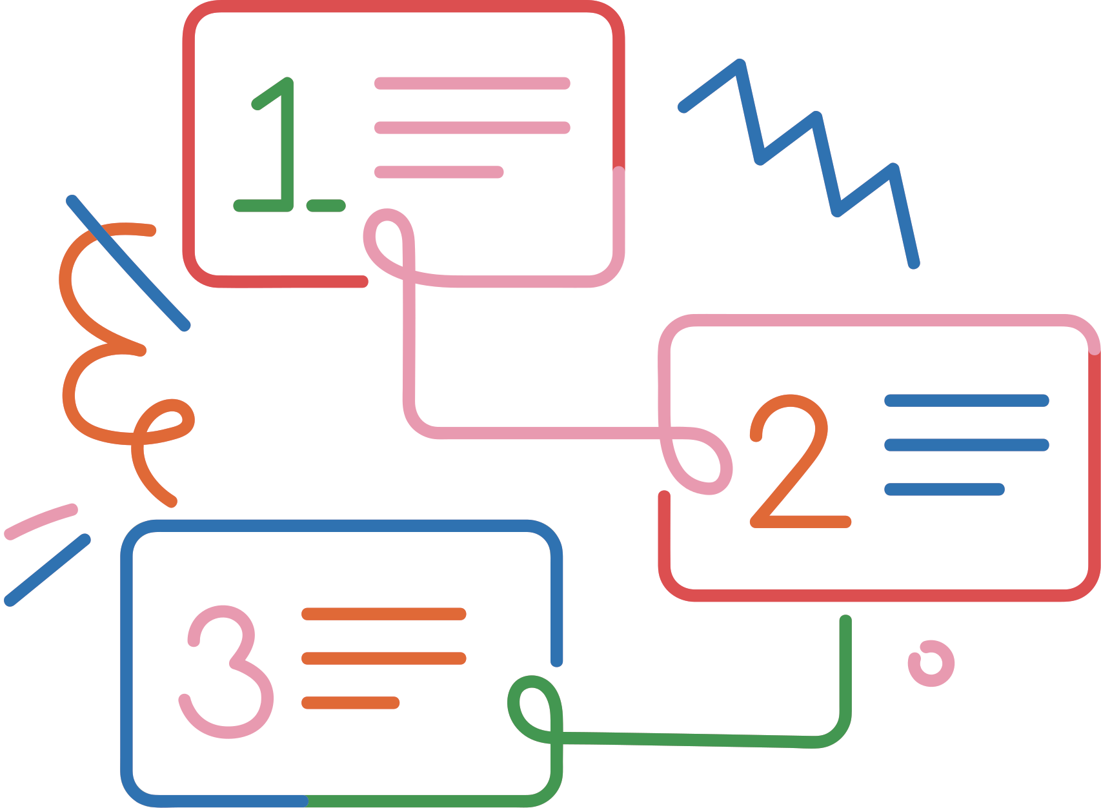

Index
Problem Statement
Challenges
Our Approach and Solution
Workflow
UML diagram
High-level diagram
Our Ecosystem
Key Features
Future Scope

Slide 3


Problem Statement
The healthcare industry faces significant challenges in achieving seamless integration and collaboration among its stakeholders, including doctors, patients, labs, pharmacies, administrators, insurers, and government bodies.
Key issues include:
Fragmented Stakeholder Interaction: Inefficient communication among stakeholders disrupts coordination.
Data Management Issues: Errors and delays in handling patient data hinder workflows.
Financial Inefficiencies: Outdated systems cause discrepancies in billing and insurance claims.
Administrative Burdens: Managing employees and cross-network data is complex and error-prone.
Government Fund Allocation Challenges: Inefficient processes hinder transparent and effective fund utilization.

Slide 4

Challenges
Fragmented Systems: Poor integration among stakeholders leads to inefficiencies and delays.
Data Management Issues: Scattered patient data causes errors and hinders secure access.
Workflow Gaps: Manual processes and poor communication create bottlenecks.
Financial Complexity: Inefficient billing and claims processes delay reimbursements.
Security Risks: Weak authentication and non-compliance expose sensitive data.
Limited Scalability: Systems struggle with growing demands and lack advanced technology.

Slide 5
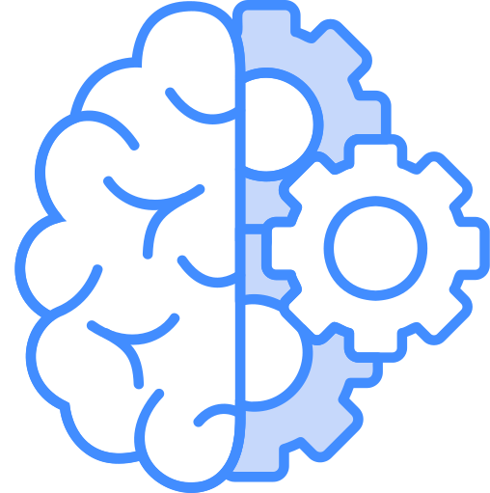





Our Approach & Solution
THE NEED AND COMPONENTS FOR A CENTRALIZED SOLUTION
Unified Database: A secure, real-time platform for all Administrator to manage and access data.
Streamlined Workflows: Automated processes for scheduling, prescriptions, billing, and fund allocation.
Enhanced Collaboration: Seamless communication for coordinated healthcare delivery.
Privacy and Security: Advanced measures to safeguard sensitive information.
Unified DB
Automated Workflow
Fund Management
Privacy and Security
Analytics and Insights

Slide 6





Workflow
Lab, Accountant, Doctor, Patient
Healthcare Admin
Healthcare Enterprise
Government Officer
Government Admin
Government Enterprise
System Admin
Insurance Agent and Manager
Insurance Admin
Insurance Enterprise
Pharmacist
Pharmacy Admin
Pharmacy Enterprise

Slide 7
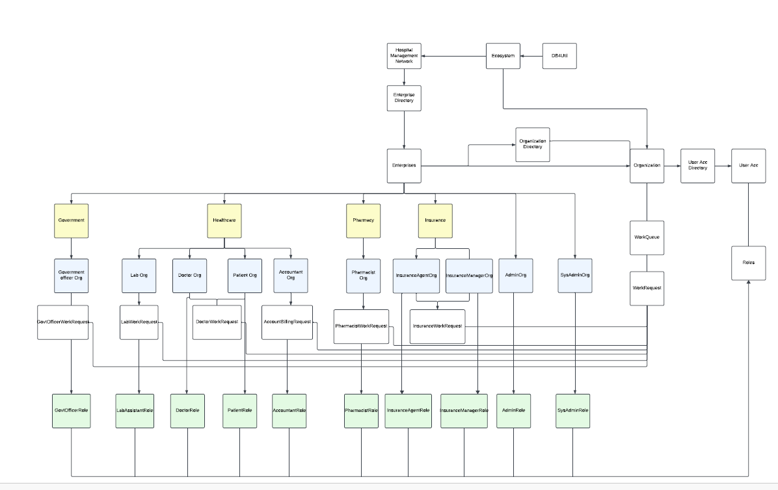
UML Diagram

Slide 8
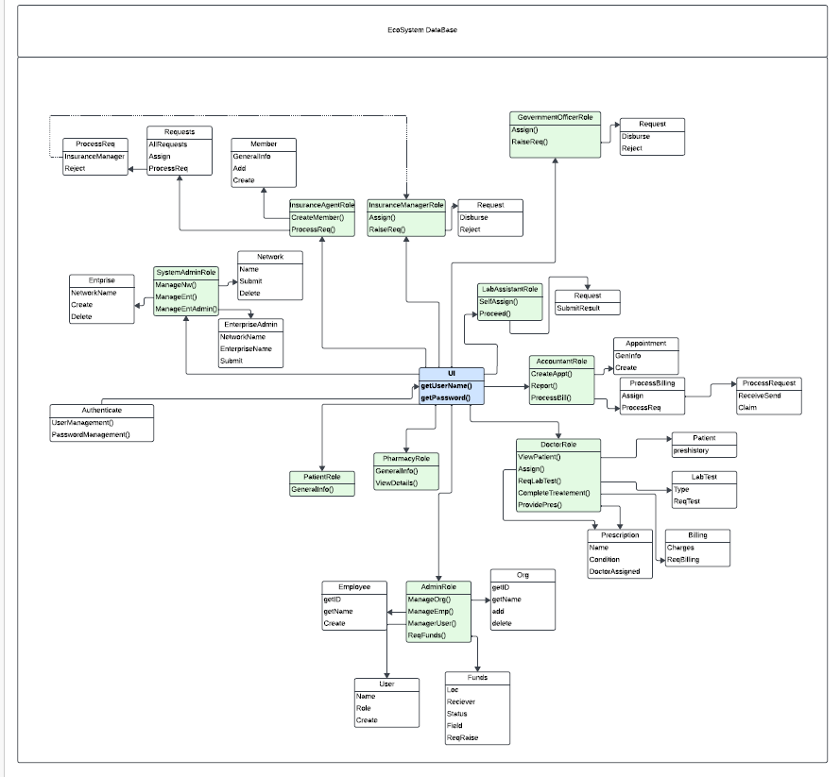
High-level Diagram

Slide 9

Our Ecosystem
Integration: Connects doctors, patients, lab assistants, pharmacists, accountants, and external entities like insurance agents and government bodies.
Centralized Database: Secure and unified storage for healthcare data.
Interoperability: Seamless integration with external platforms like insurance and government programs.
Key Modules: Includes appointment scheduling, lab/pharmacy management, and billing/claims processing.
Collaboration & Efficiency: Streamlines workflows and enhances healthcare delivery.

Slide 10



Key Features
Role-Based Access: Tailored tools and permissions for each stakeholder.
Centralized Data Management: Secure, unified storage for healthcare data.
Automated Workflows: Streamlined task assignments and communication.
Integrated Billing and Insurance: Simplified financial operations and claims processing.
Patient Portals: Access to medical histories, prescriptions, and appointments.
Scalability and Interoperability: Supports growth and connects with external systems.

Slide 11

Future Scope
AI-Powered Analytics: Predictive tools for diagnosis, resource allocation, and risk assessment.
IoT Integration: Real-time health monitoring through wearable devices.
Telemedicine Support: Virtual consultations and remote prescription management.
Blockchain Security: Enhanced data transparency and secure record sharing.
Global Healthcare Collaboration: Cross-border integration with international health systems.
Customized Modules: Tailored solutions for specialized healthcare services.

Slide 12

Thank You

